Slide 1
Surveillance and Dark Matter
March 7, 2017

Slide 2
Manhunter
https://www.youtube.com/watch?v=uHc9NI2FRDk&feature=youtu.be

Slide 3
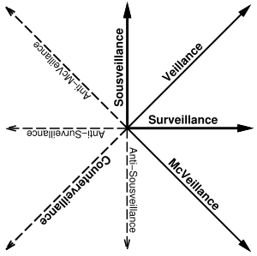
Steve Mann’s Veillance Plane

Slide 4
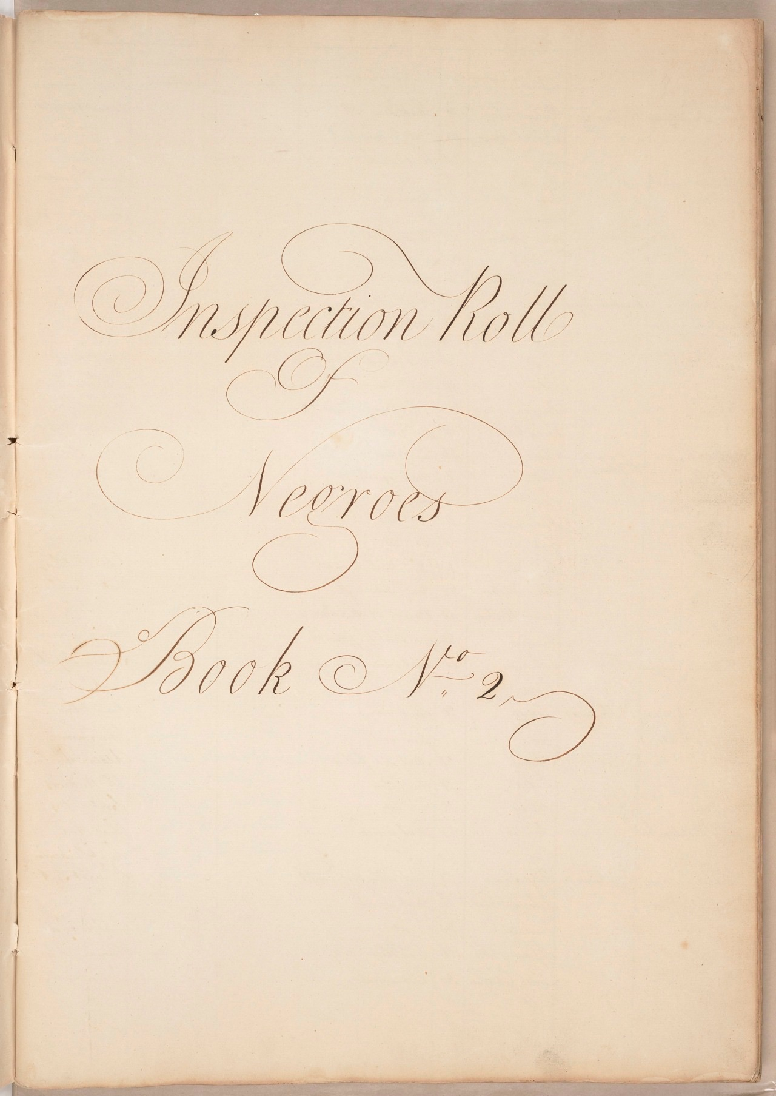
Book of Negroes
1779 proclamation by Sir Henry Clinton
3000 passengers left New York in 1783
1st government issued document for state regulated migration between the US and Canada that explicitly linked corporeal markers to the right to travel
Birch Certificates decided at Fraunces Tavern gave permission for slaves to leave or continue on their way if already on ships
http://www.blackloyalist.info/source-image-display/display/94

Slide 5
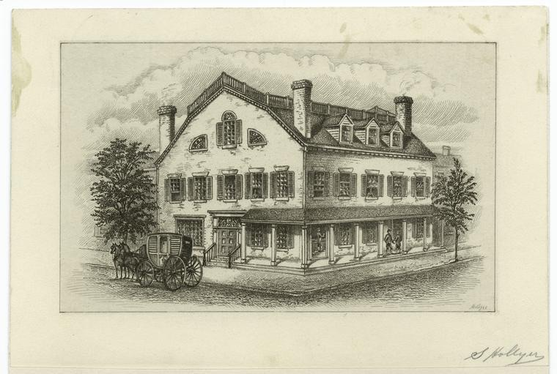
Fraunces Tavern
1783 event at Fraunces Tavern made it a site of "de-commodificatory narrative acts”
telling stories
talking back,
“out of place”
“boldface"
black refusal and critique as anti-surveillance
black repossession through testimony
“performative sensibility” of being seen challenges “unvisibility"
Fraunces Tavern (Pearl and Broad in Lower Manhattan) as a black diasporic site
Ex: Lantern Laws after 1712 slave revolt

